Slide 1
Environment & Tools

Slide 2
Elements in working environmet
Navegador:
Chrome
Editor de código: Visual Studio Code https://code.visualstudio.com/
Node.js y npm (gestor de paquetes ) https://nodejs.org/es/
Git y una cuenta en GitHub https://git-scm.com/ https://github.com/
Versiones ‘genéricas’; herramientas de desarrollo
Versiones para desarrollo
Ayuda de escritura ágil de HTML y CSS con Emmet
Plugins adecuados a cada lenguaje / framework
Entorno de ejecución de JS, habitualmente para ell lado servidor
Incorpora npm como gestor de paquetes y dependencias
Webpack https://webpack.js.org/
Gestor de tareas:
compilación de CSS, transpilación de TS, empaquetado de la aplicación final (bundles)
Git para la gestión del repositorio de software
GitHub como hosting de repositorios

Slide 3
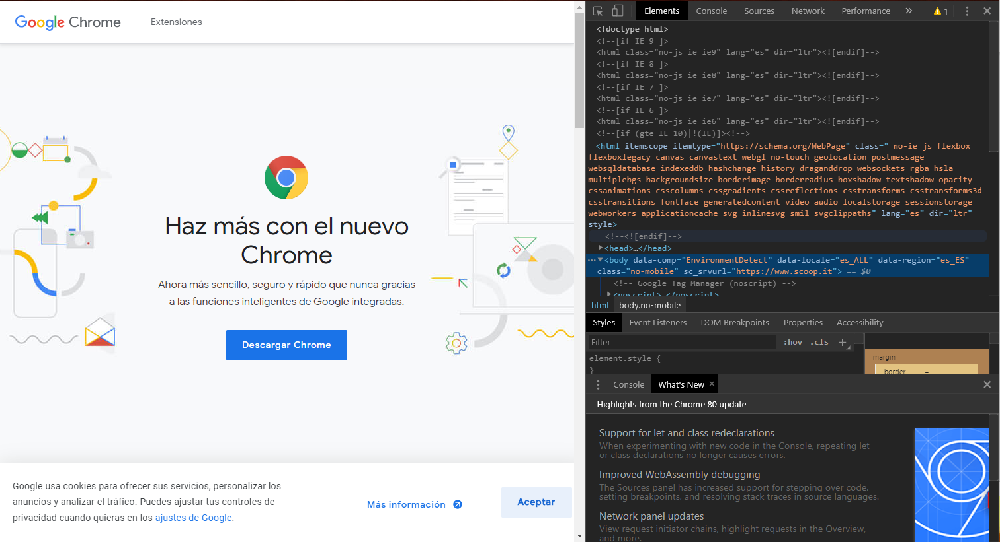
Chrome
Developer Tools
[F12]

Slide 4
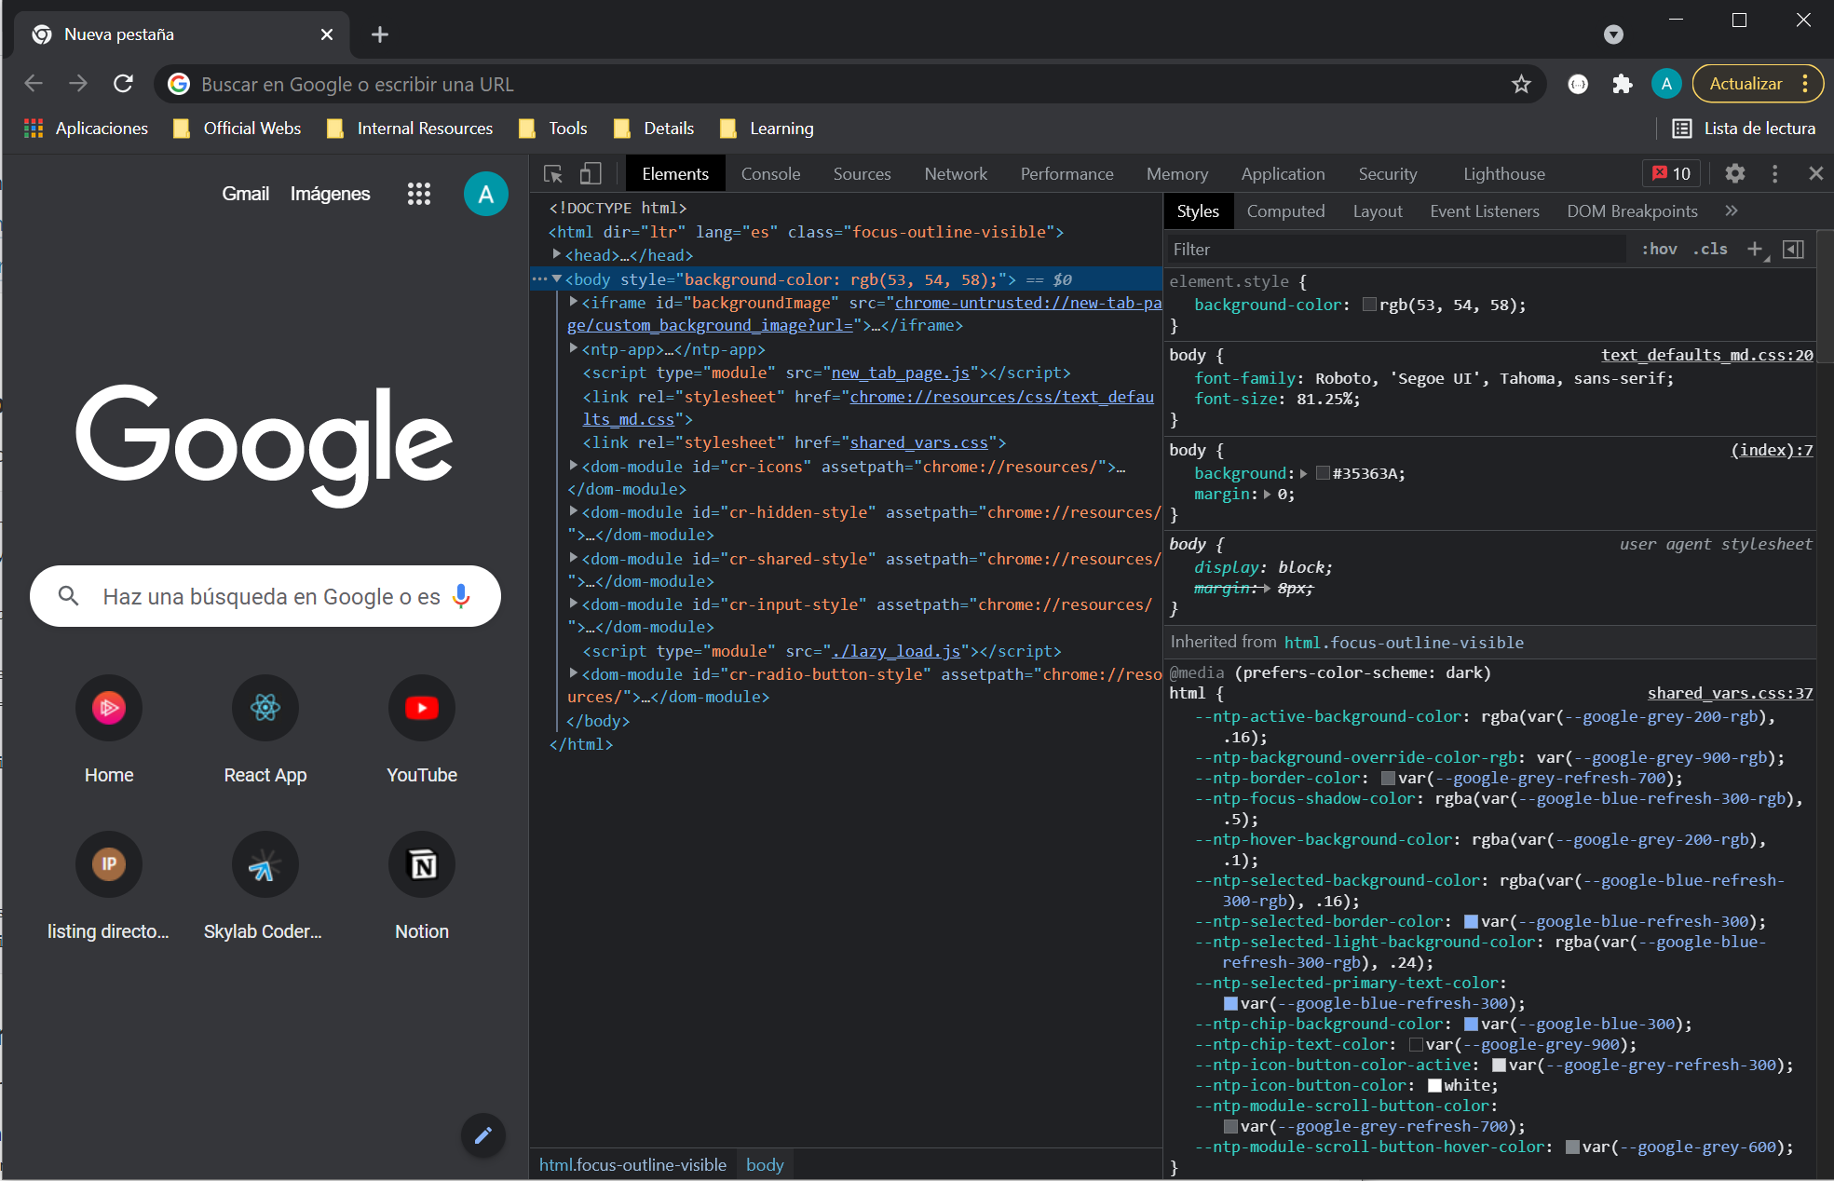
Browser developer tools
Elements
Console
Sources
Network
Performance
Memory
Application
Security
Lighthouse

Slide 5
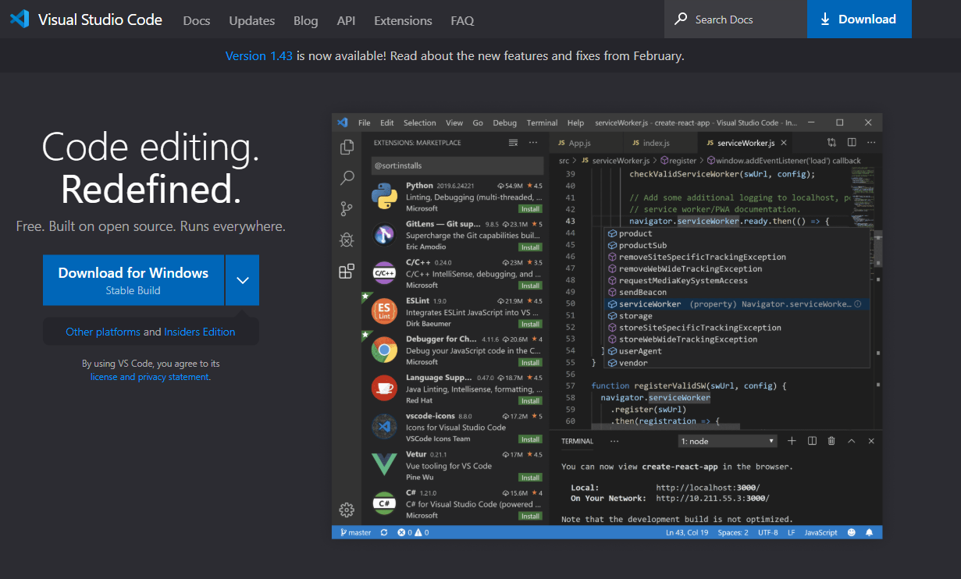
Visual Studio Code
https://code.visualstudio.com/

Slide 6
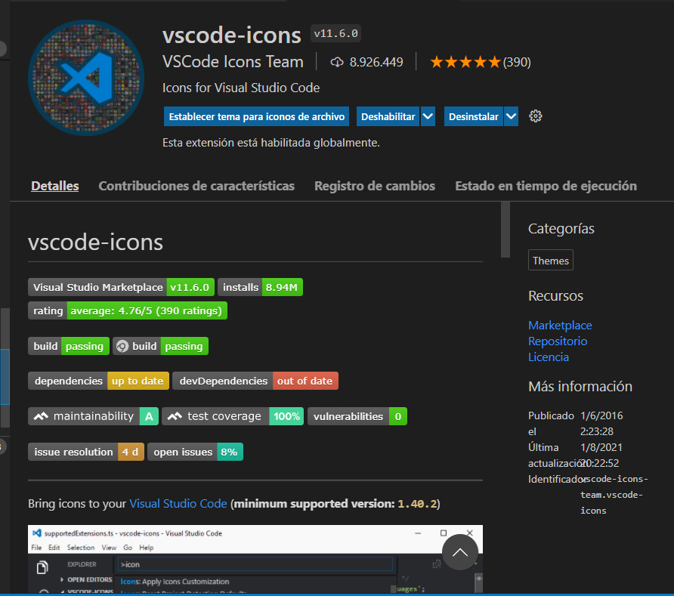

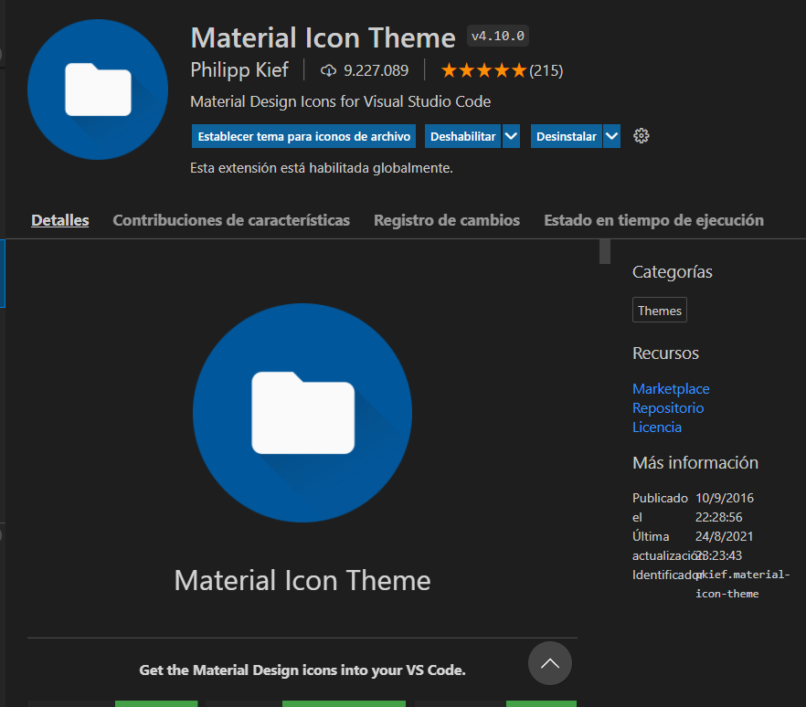
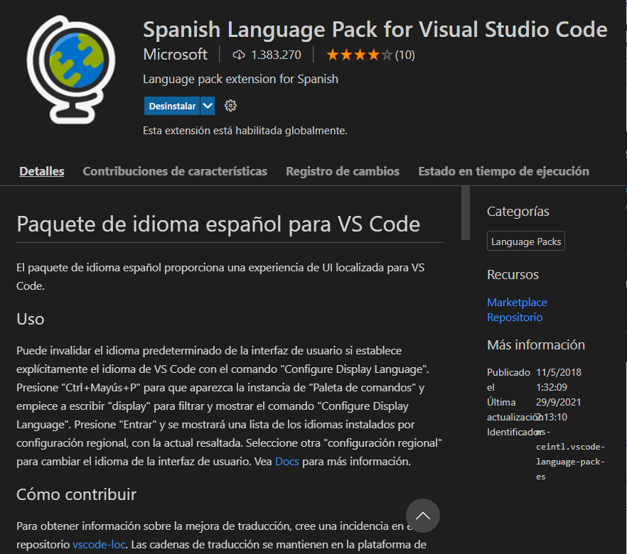
Plugins for VSC Style
Spanish Language Pack for VSC
Icon Themes

Slide 7
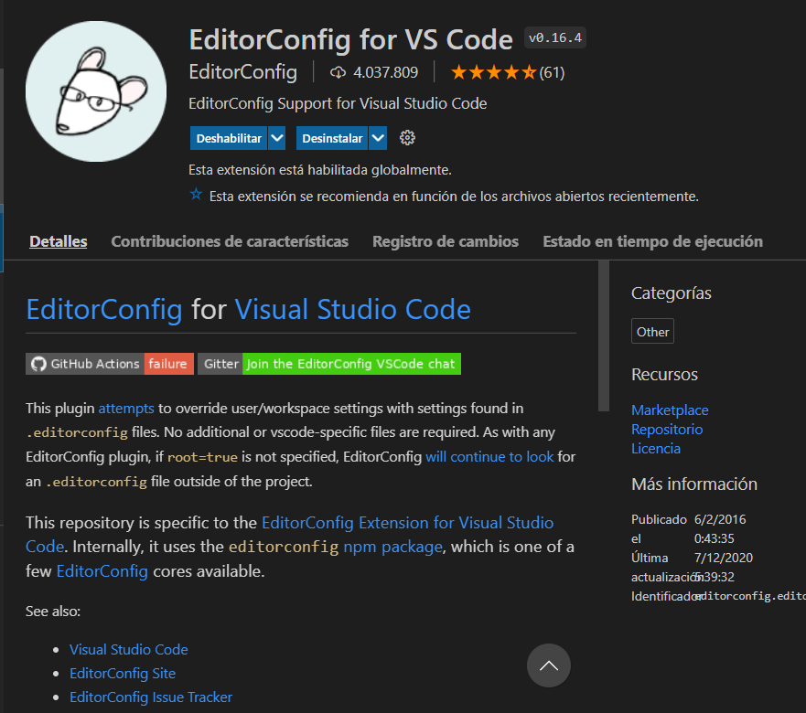
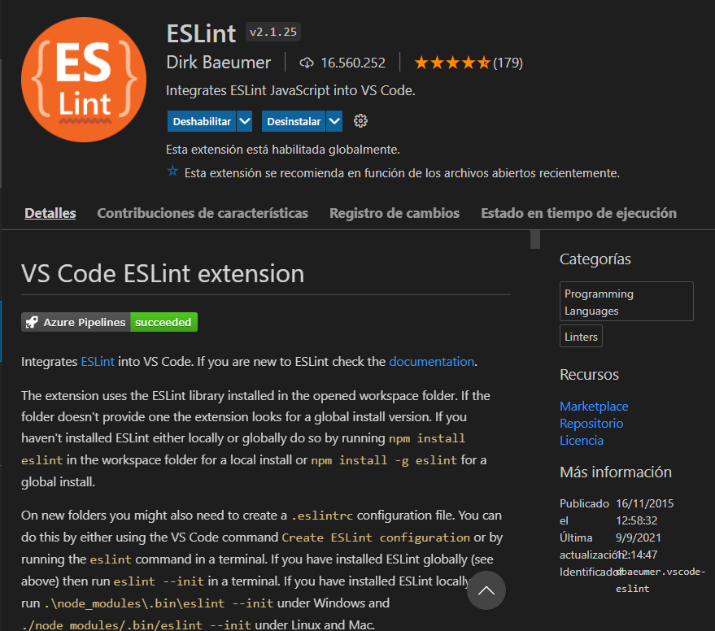
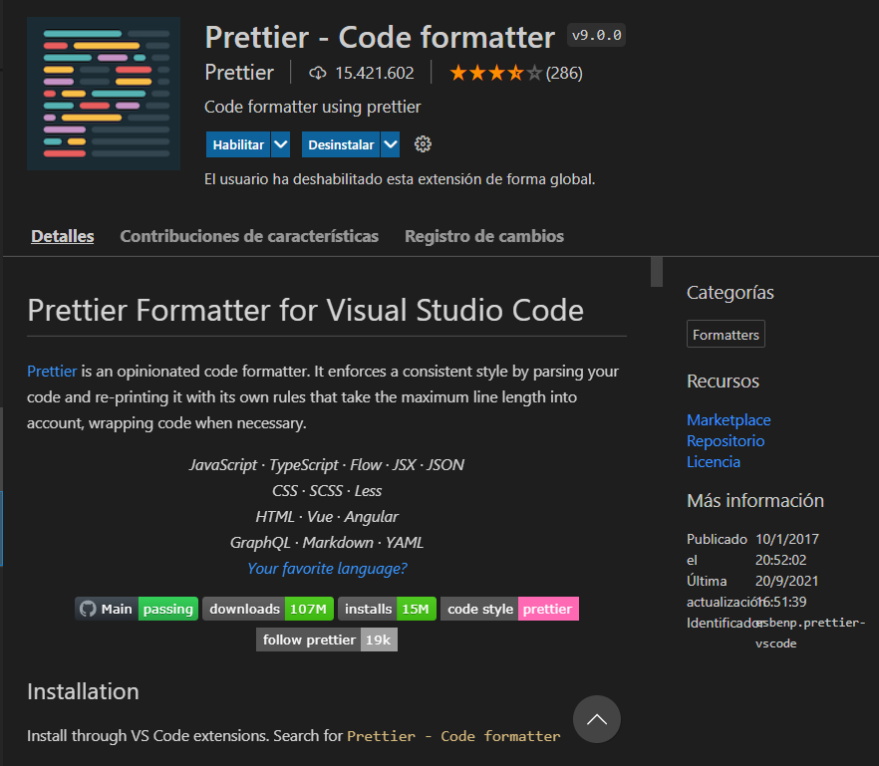
Plugins for formatting code
EditorConfig for VS Code
ESLint (de Dirk Baeumer)
Prettier (de Prettier)

Slide 8
EditorConfig Configuration
indent_style: set to tab or space.
indent_size: number of columns for each indentation level and soft tabs (when supported). (When set to tab, tab_width (if specified) will be used.)
tab_width: number of columns used to represent a tab character. (This defaults to the value of indent_size and doesn't usually need to be specified.)
end_of_line: lf, cr, or crlf to control how line breaks are represented.
charset: latin1, utf-8, utf-8-bom, utf-16be or utf-16le to control the character set.
trim_trailing_whitespace: set to true (remove any whitespace characters preceding newline characters) or false
insert_final_newline: set to true (ensure file ends with a newline) or false
.editorconfig
[*]
charset = utf-8
end_of_line = lf
indent_size = 2
indent_style = space
insert_final_newline = true
trim_trailing_whitespace = true
Values also used by Prettier

Slide 9
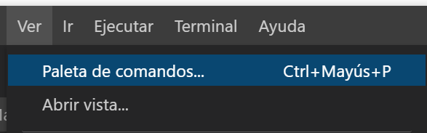
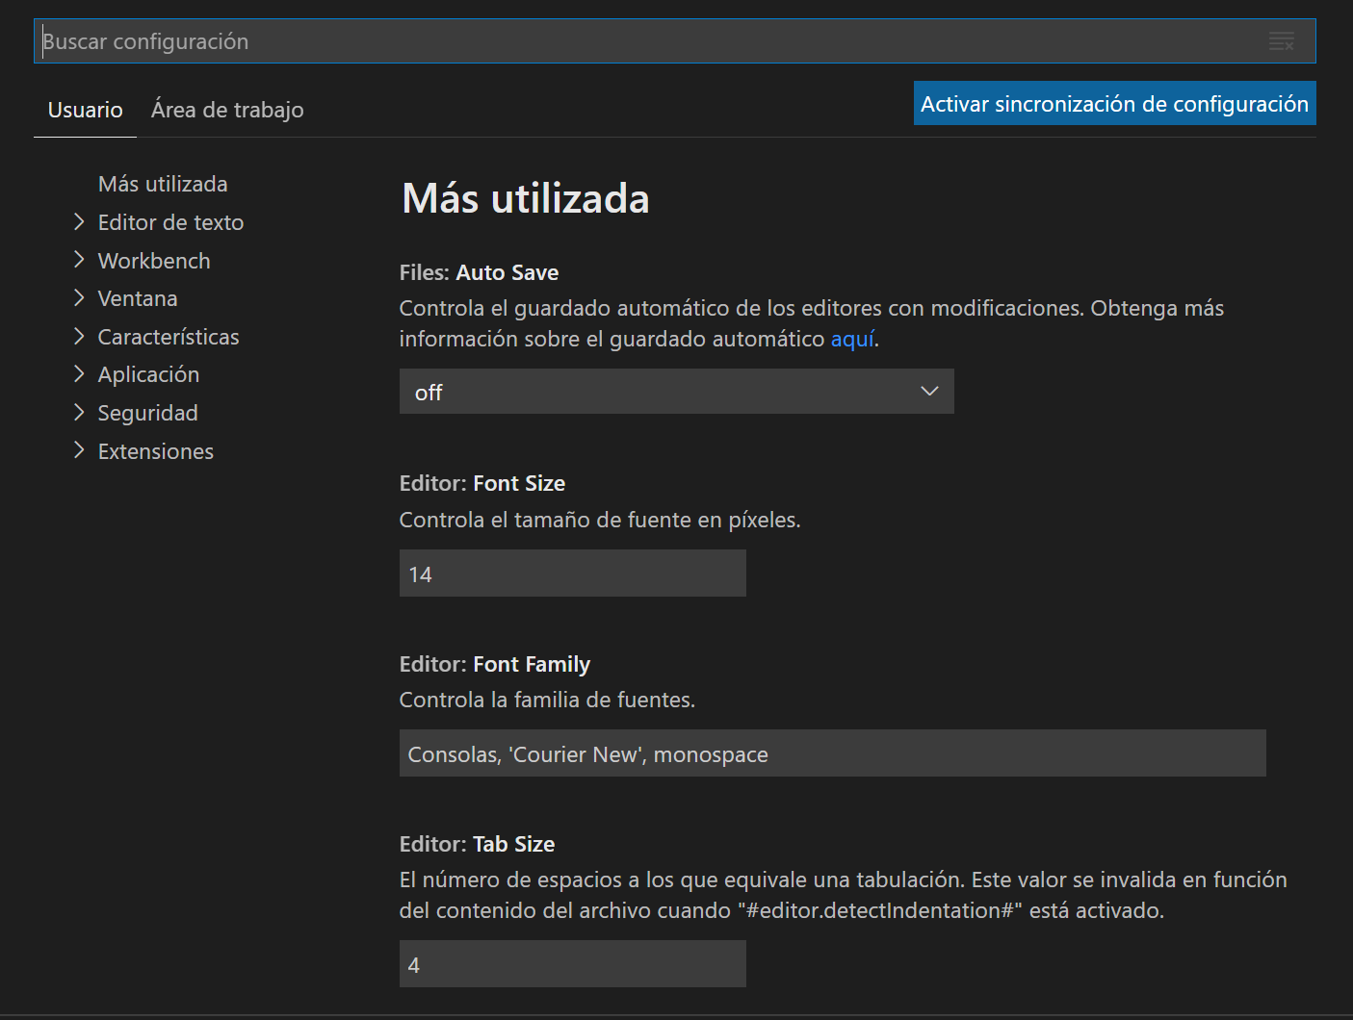
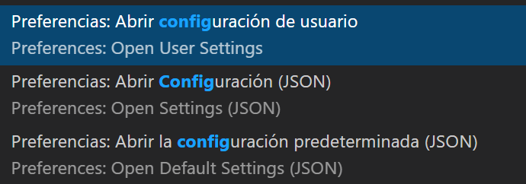
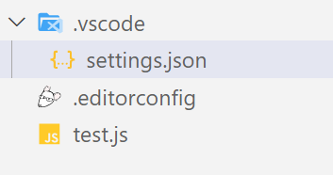
VSC Configuration
{
"workbench.colorTheme": "Visual Studio Light"
}

Slide 10
VSC Configuration for Prettier
{
"security.workspace.trust.untrustedFiles": "open",
"terminal.integrated.defaultProfile.windows": "Command Prompt",
"window.zoomLevel": 1,
"workbench.iconTheme": "material-icon-theme",
"editor.formatOnSave": true,
"editor.defaultFormatter": "esbenp.prettier-vscode",
}
Prettier configuration
This extension will use prettier from your project's local dependencies (recommended). When the prettier.resolveGlobalModules is set to true the extension can also attempt to resolve global modules.
Should prettier not be installed locally with your project's dependencies or globally on the machine, the version of prettier that is bundled with the extension will be used.
To install prettier in your project and pin its version as recommended, run:
npm install prettier -D --save-exact

Slide 11
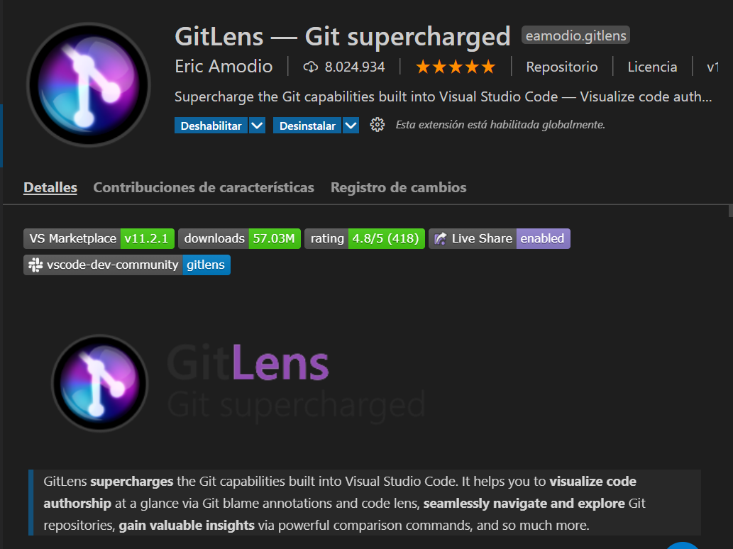
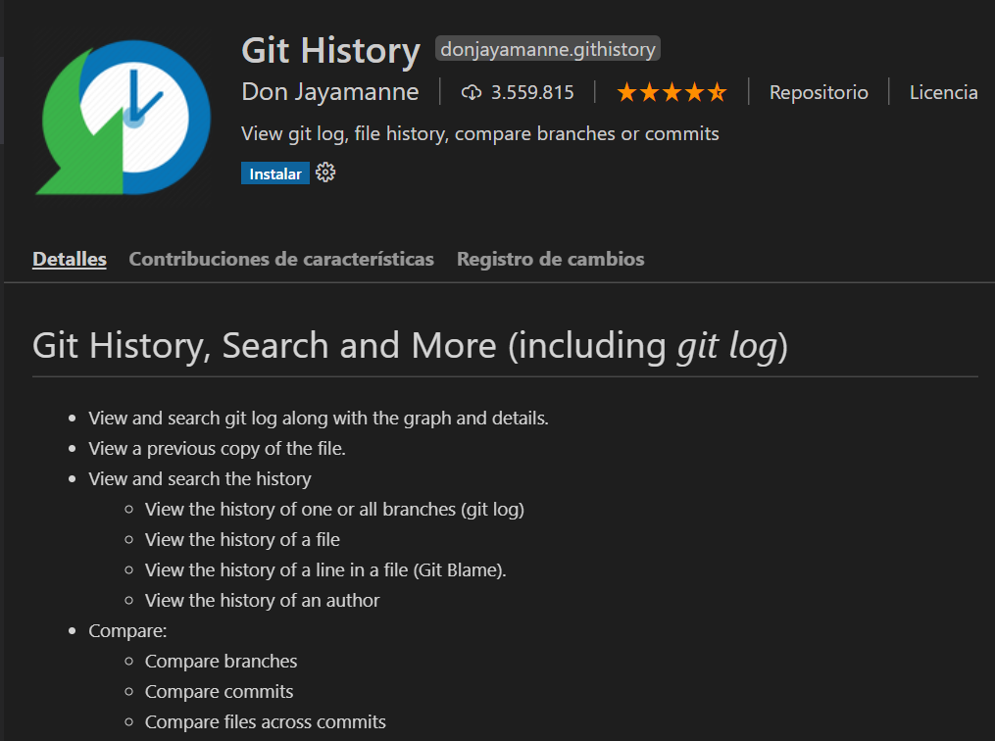
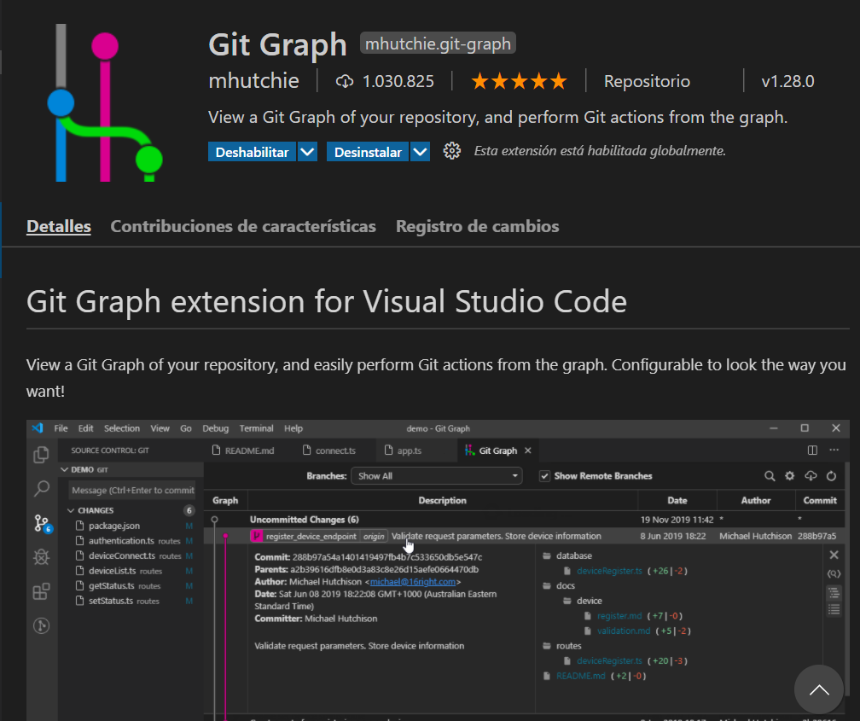
Plugins for Git/GitHub
GitLens
Git History
Git Graph

Slide 12
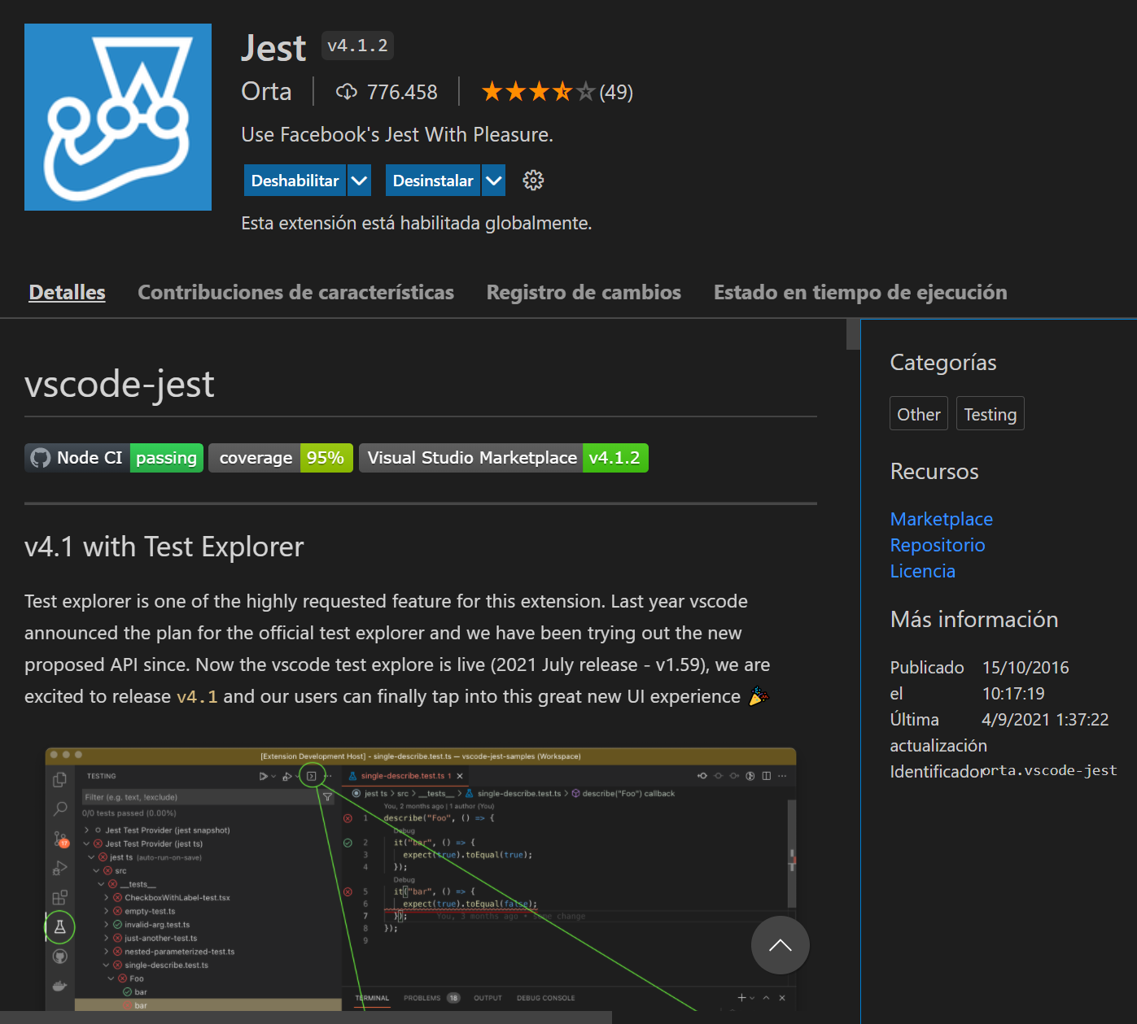
Plugins for testing code
Jest (de Orta)

Slide 13
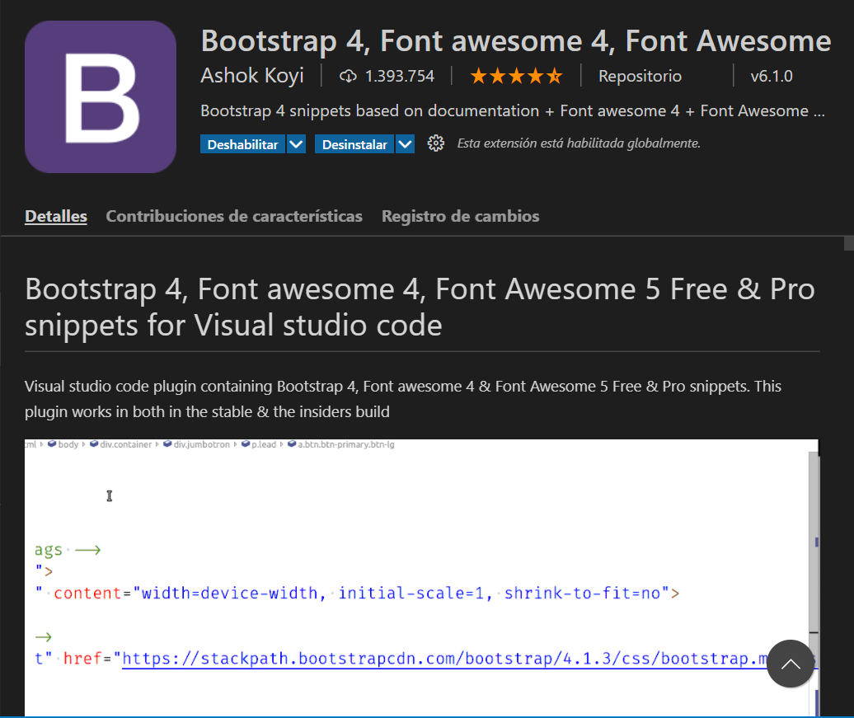
Plugins for Bootstrap
Bootstrap 4, Font awesome 4

Slide 14
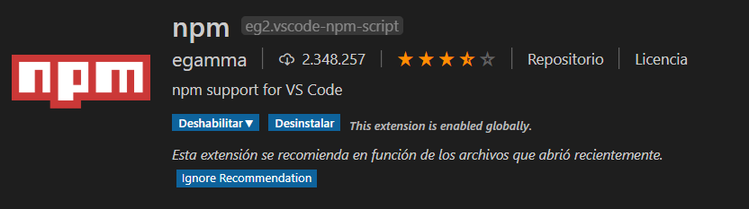
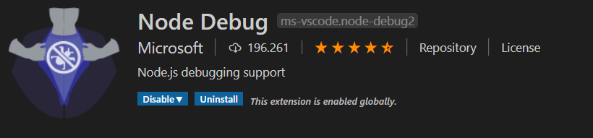
Plugins para Node JS
npm
Node Debug

Slide 15
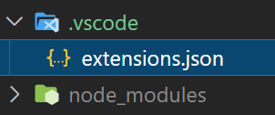
Recommended Plugins
EditorConfig for VS Code
ESLint (de Dirk Baeumer)
Prettier (de Prettier)
Git Graph
GitLens
Jest (de Orta)
Spanish Language Pack for VSC
Materia Icon Theme / vscode-icons (de VSCode Icons Team)
LiveServer
Rest-client
Markdown-shortcuts
Recommended pluggins for a project

Slide 16
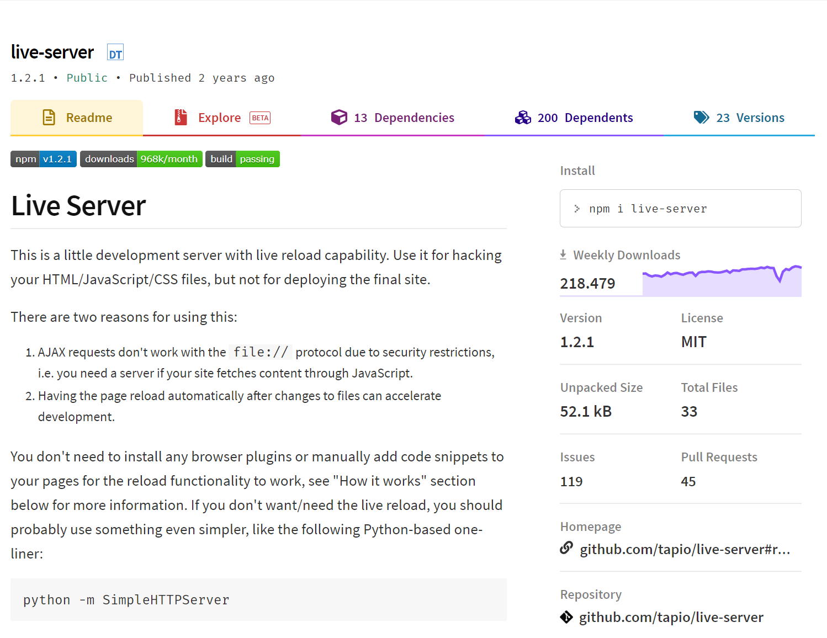
Servidores Web de desarrollo
Live-server
npm install -g live-server
https://www.npmjs.com/package/live-server

Slide 17
VSC Final Settings
"editor.formatOnSave": true,
"editor.formatOnPaste": true,
"editor.defaultFormatter": "esbenp.prettier-vscode",
"editor.codeActionsOnSave": {
"source.fixAll.eslint": true
},
"javascript.suggestionActions.enabled": false,
"javascript.updateImportsOnFileMove.enabled": "always",
"emmet.includeLanguages": {
"javascript": "javascriptreact",
"typescript": "typescriptreact"
},
"js/ts.implicitProjectConfig.experimentalDecorators": true,
"typescript.suggestionActions.enabled": false,
"typescript.updateImportsOnFileMove.enabled": "always"
"editor.bracketPairColorization.enabled": true",

Slide 18
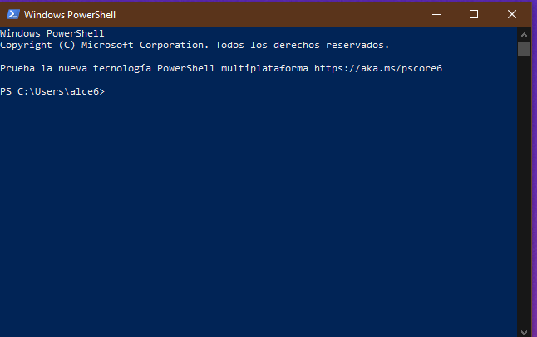
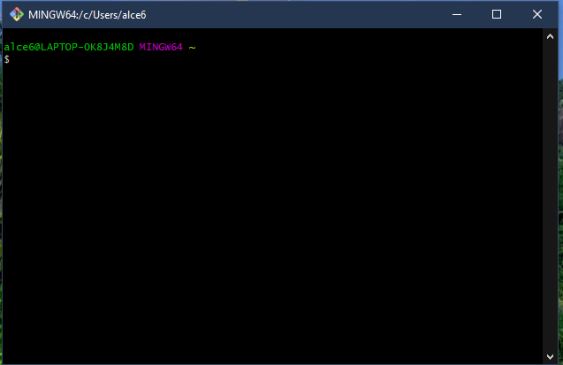
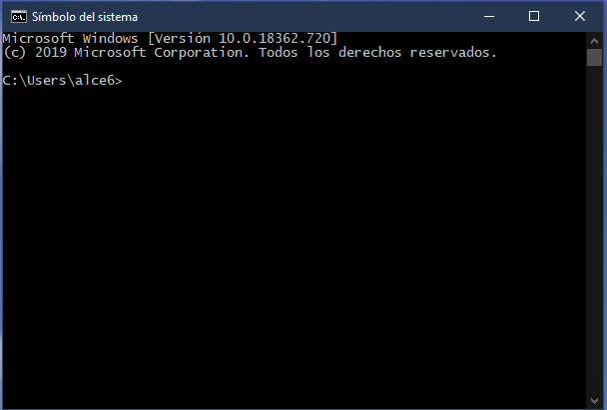
Terminal o línea de comandos (Windows)
Cmd (Símbolo del sistema)
PowerShell
Git Bash
Es posible acceder a cualquiera de ellos desde VSC
El cmd permite ejecutar scripts y suele ser suficiente en la mayoría de los casos

Slide 19
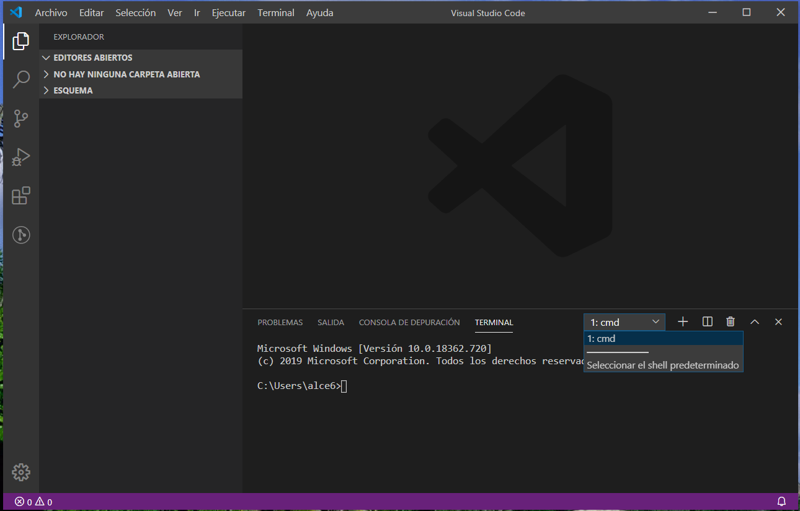
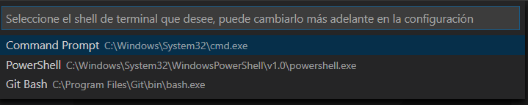
Terminales en VSC

Slide 20
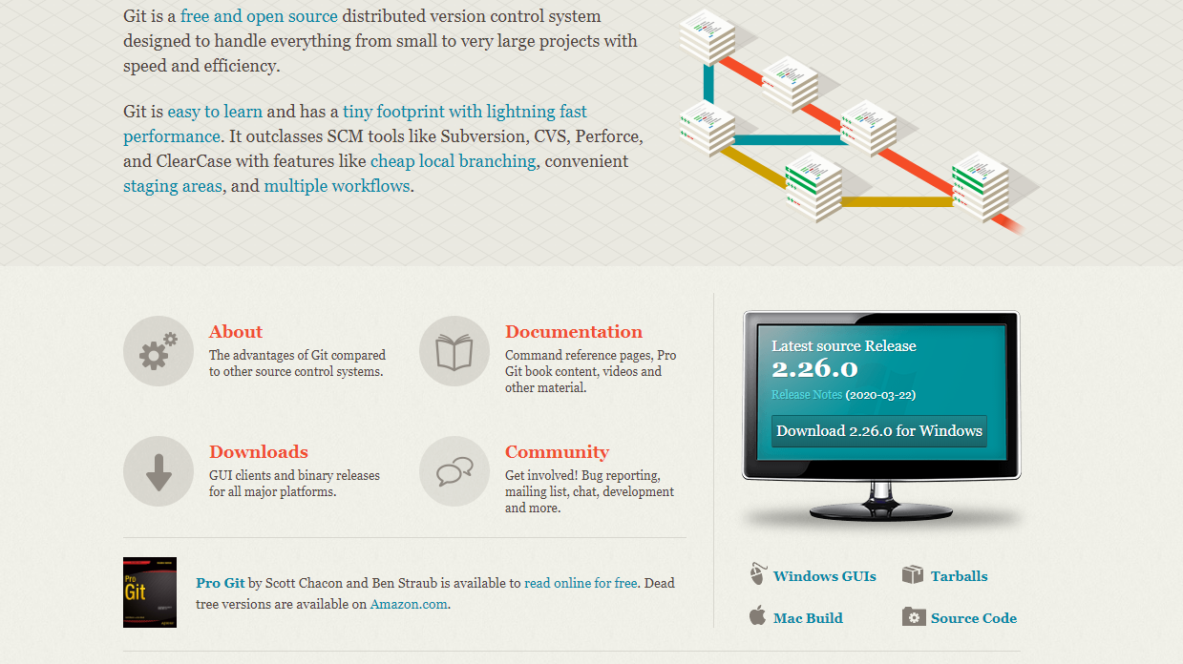
Git
https://git-scm.com/

Slide 21

GitHub
https://github.com/

Slide 22
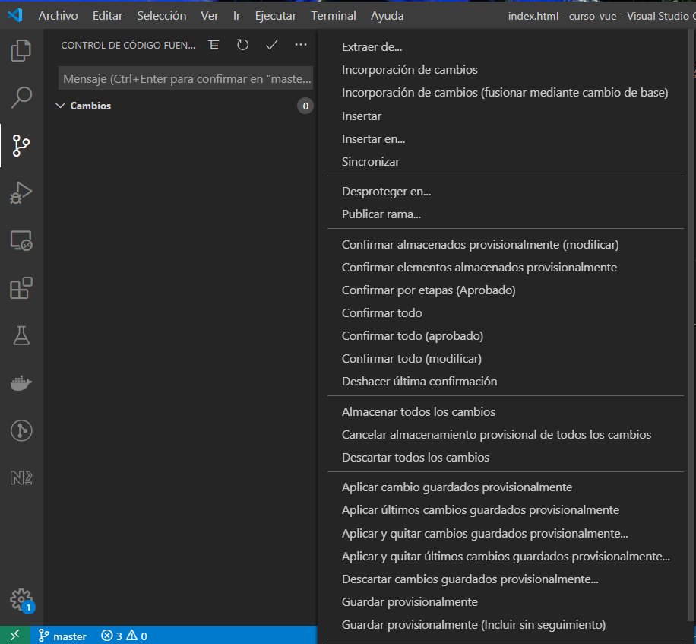
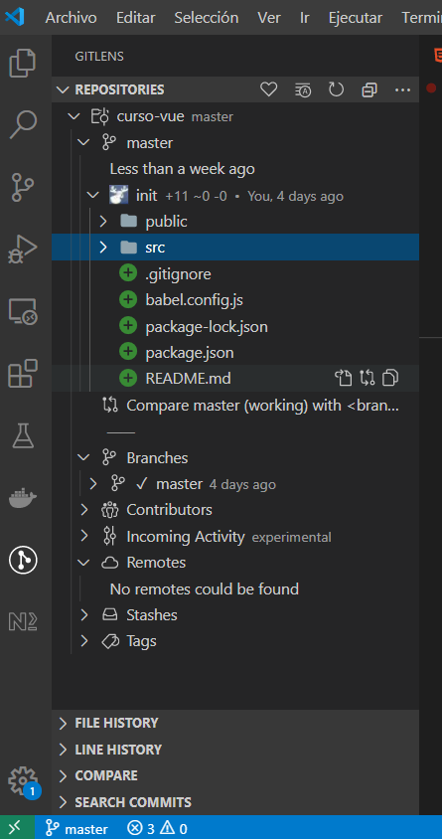
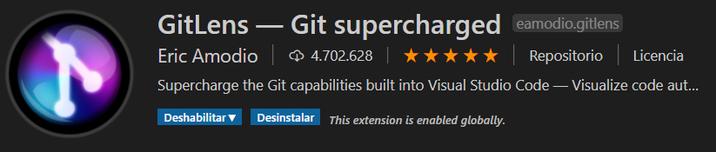
Git desde VSC
Soporte nativo en VSC

Slide 23
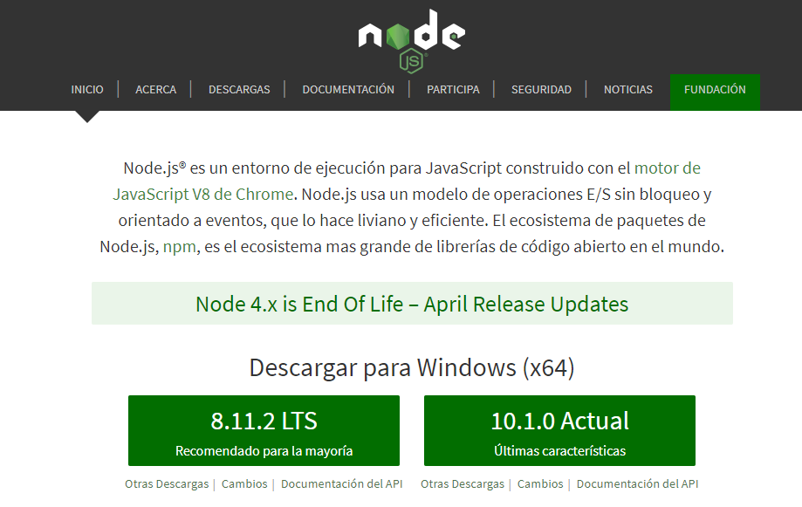

Entorno: Node JS / nmp

Slide 24
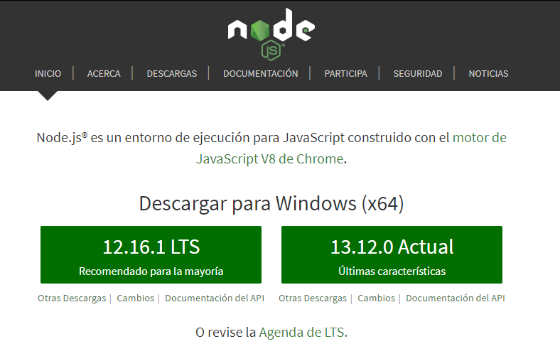
Node JS
https://nodejs.org/es/

Slide 25
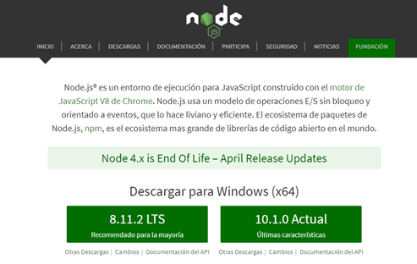
¿Qué es NodeJS? – Técnicamente
Node.js® es un entorno de ejecución para JavaScript construido con el motor de JavaScript V8 de Chrome.
V8
Una gramática que define su sintaxis
Un compilador que lo interpreta y ejecuta
Node.js
Mecanismos para interactuar con el exterior
Librería estándar (consola, ficheros, red, etc.
Utilidades (intérprete, depurador, paquetes, etc.
 | Node JS
Lenguaje | JavaScript (ES6+)
Motor | V8
Entorno | Módulos de core
Frameworks | Express…
Node.js usa un modelo de operaciones E/S Sin bloqueo y orientado a eventos, que lo hace liviano y eficiente. El ecosistema de paquetes de
npm, es el ecosistema grande de código abierto en el mundo.

Slide 26
¿Qué es NodeJS? – En la práctica
Plataforma de desarrollo de software creada en 2009
JavaScript en el lado del servidor
Basado en la máquina virtual de Chrome V8: escrito en C = muy rápido
Multiplataforma (Windows, Macintosh, Linux, etc.)
Aunque es una marca registrada de Joyent, es open source
Asíncrono y orientado a eventos
Ideal para aplicaciones que consumen datos en tiempo real y que se ejecutan a través de dispositivos distribuidos
Lo usan muchas empresas (Walmart, PayPal, Yahoo, LinkedIn, eBay, Uber, etc.)

Slide 27
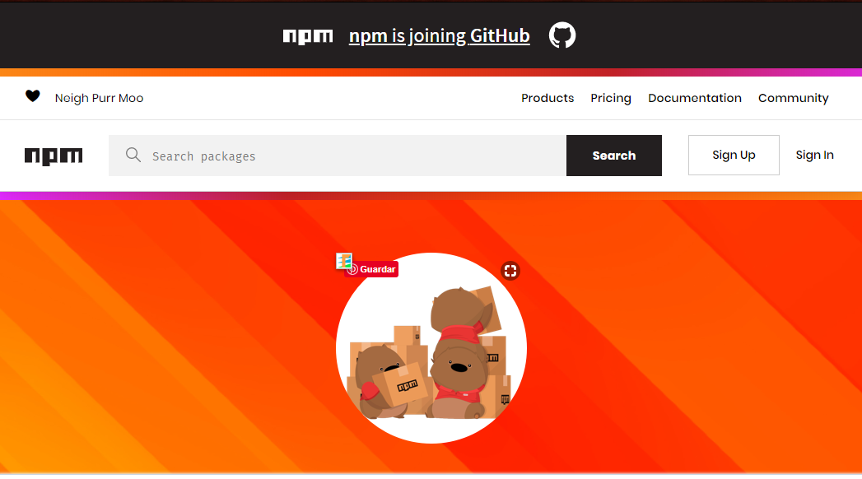
Node/npm
https://www.npmjs.com/

Slide 28
npm: instalación de paquetes
npm install <paquete> | instala localmente el paquete indicado
npm install | instala localmente todas las dependencias recogidas en package.json
npm install –g <paquete> | instala globalmente el paquete indicado
npm list -g --depth 0 | lista los paquetes instalados globalmente
C:\...>npm list -g --depth 0
C:\Users\alce6\AppData\Roaming\npm
+-- @angular/cli@11.2.0
+-- @vue/cli@4.5.8
+-- @vue/cli-service-global@4.2.3
+-- cordova@9.0.0
+-- eslint@6.8.0
+-- gulp-cli@2.2.0
+-- ionic@4.12.0
+-- json-server@0.16.3
+-- live-server@1.2.1
+-- node-sass@4.13.0
+-- npm@6.14.8
+-- ts-node@9.1.1
`-- typescript@4.1.5

Slide 29
Npx – ejecutor de paquetes npm
es un ejecutor de paquetes binarios de npm
preinstalado con npm desde la versión 5.0.2
es una herramienta CLI para facilitar la instalación y la gestión de las dependencias alojadas en el registro npm.
al ejecutar cualquier paquete basado en Node.js evita tener que instalarlo como paquete global para poder ejecutarlo
evita tener que crear un script npm para ejecutar binarios locales.
¿Qué es npx? - https://xavitristancho.pro/blog/que-es-npx
npm vs npx - https://www.freecodecamp.org/espanol/news/npm-vs-npx-cual-es-la-diferencia/

Slide 30

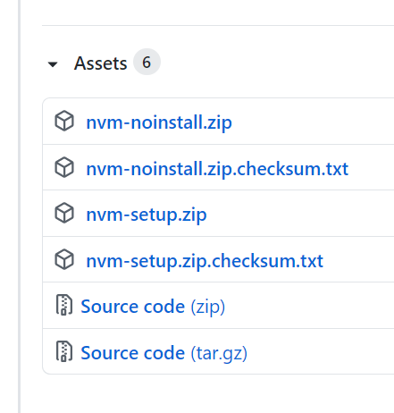
Versiones de Node: nvm
POSIX (Linux, Mac)
https://github.com/nvm-sh/nvm
Windows
https://github.com/coreybutler/nvm-windows

Slide 31
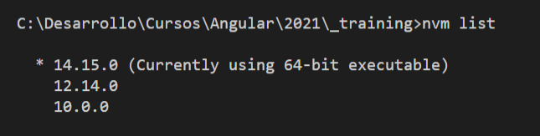
NVM Windows
nvm install <version> [arch]
nvm list
nvm list available
nvm use [version] [arch]

Slide 32

Instalación de NodeJS
Una sola versión. Comprobación
descarga e instalación de NodeJS
$ node -v
$ npm -v
Múltiples versiones - nvm Windows https://github.com/coreybutler/nvm-windows
descarga e instalación de nvm
$ nvm install <versión>
$ nvm list
$ nvm use <versión>

Slide 33
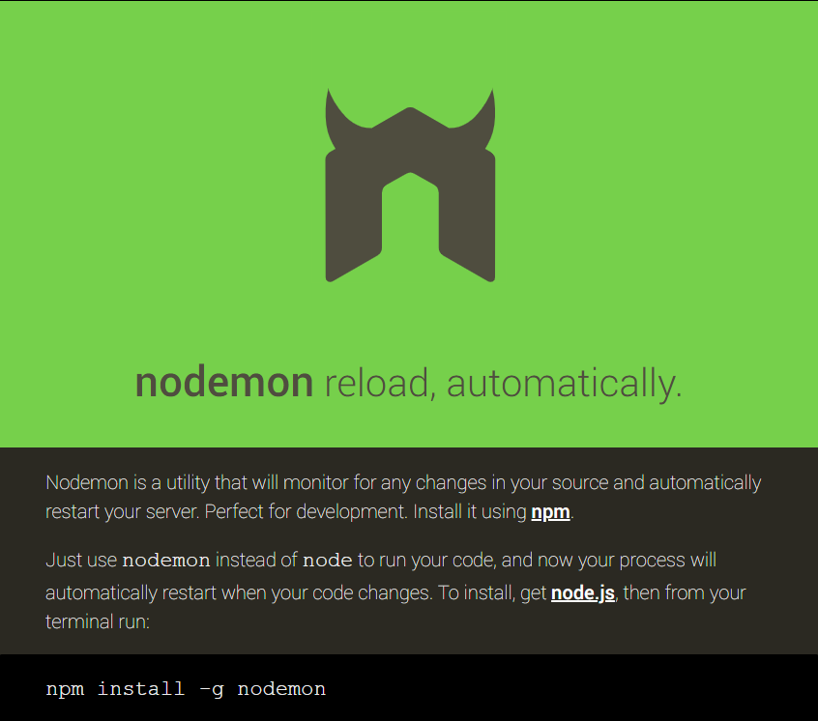
Nodemon https://nodemon.io/
Herramientas de Desarrollo
Instalación global npm $ npm list -g –depth=0

Slide 34
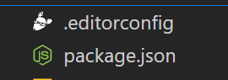
Initialization of npm project
npm init
npm init -y
{
"name": "vanilla",
"version": "1.0.0",
"description": "",
"main": "test.js",
"scripts": {
"test": "echo \"Error: no test specified\" && exit 1"
},
"keywords": [],
"author": "",
"license": "ISC"
}

Slide 35
ESLint instalation (1)
npm initialization
eslint instalation (npm instal -D eslint)
eslint configuration (npx eslint --init)
? Does your project use TypeScript? » No / Yes
? Where does your code run? ... (Press <space> to select, <a> to toggle all, <i> to invert selection)
√ Browser
√ Node
? How would you like to use ESLint? ...
To check syntax only
To check syntax and find problems
> To check syntax, find problems, and enforce code style
? How would you like to define a style for your project? ...
> Use a popular style guide
Answer questions about your style
Inspect your JavaScript file(s)
? What type of modules does your project use? ...
> JavaScript modules (import/export)
CommonJS (require/exports)
None of these
? Which style guide do you want to follow? ...
> Airbnb: https://github.com/airbnb/javascript
Standard: https://github.com/standard/standard
Google: https://github.com/google/eslint-config-google
XO: https://github.com/xojs/eslint-config-xo
Which framework does your project use? ...
React
Vue.js
> None of these
? What format do you want your config file to be in? ...
> JavaScript
YAML
JSON
React will not be selected if react-create-app will be used

Slide 36
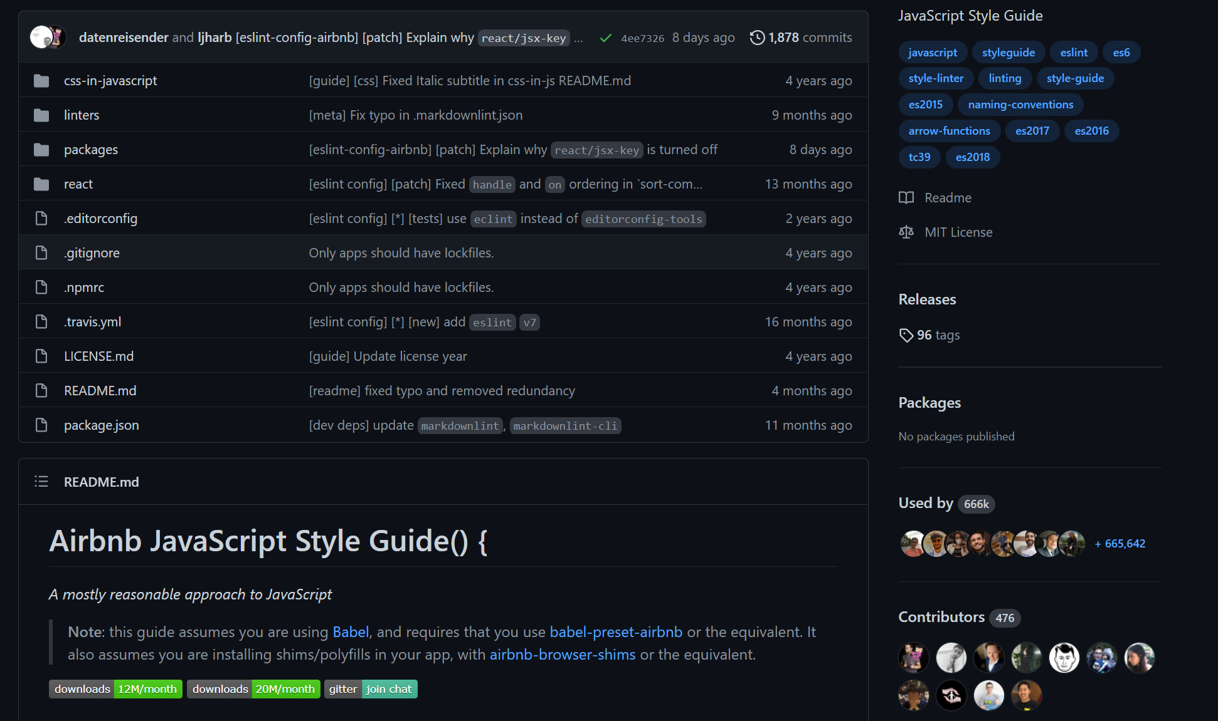
ESLint style guide
https://github.com/airbnb/javascript

Slide 37
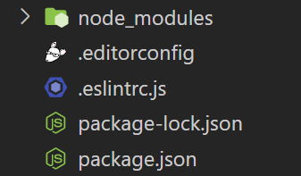
ESLint instalation (2)
npm initialization
eslint instalation (npm instal -D eslint)
eslint cofiguration (npx eslint --init)
module.exports = {
env: {
browser: true,
es2021: true,
},
extends: [
'airbnb-base',
],
parserOptions: {
ecmaVersion: 12,
sourceType: 'module',
},
rules: {
},
};
eslint-config-airbnb-base@latest
eslint@^5.16.0 || ^6.8.0 || ^7.2.0
eslint-plugin-import@^2.22.1
? Would you like to install them now with npm? » No / Yes
"scripts": {…
"lint": "eslint"
"devDependencies": {
"eslint": "^7.32.0",
"eslint-config-airbnb-base": "^14.2.1",
"eslint-plugin-import": "^2.24.2"
}
Edit and add

Slide 38
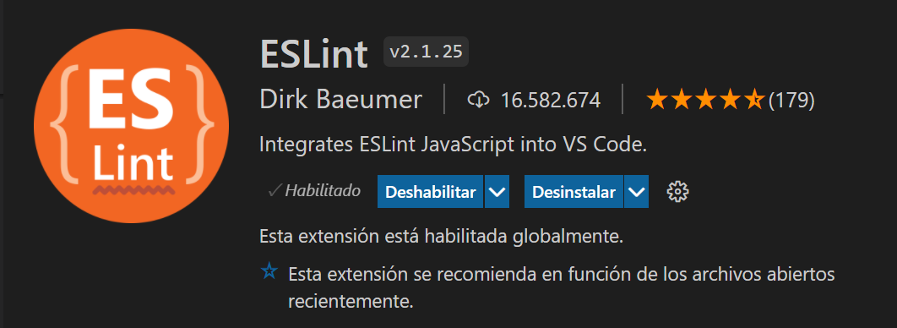
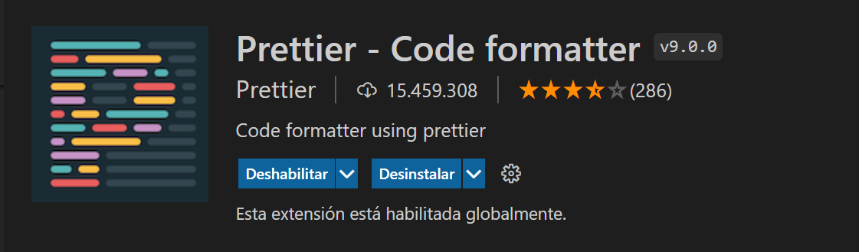
ESLint + Prettier + VSC
npm install -D eslint-config-prettier
"devDependencies": {
"eslint": "^7.32.0",
"eslint-config-airbnb-base": "^14.2.1",
"eslint-config-prettier": "^8.3.0",
"eslint-plugin-import": "^2.24.2"
}
VSC

Slide 39
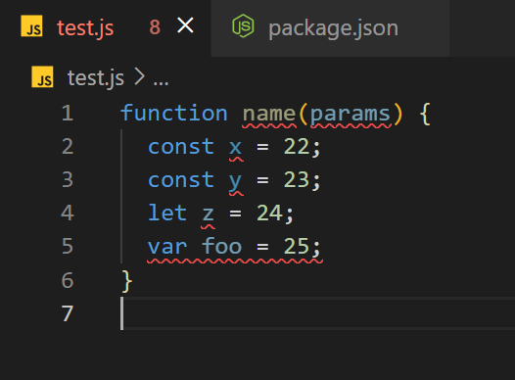
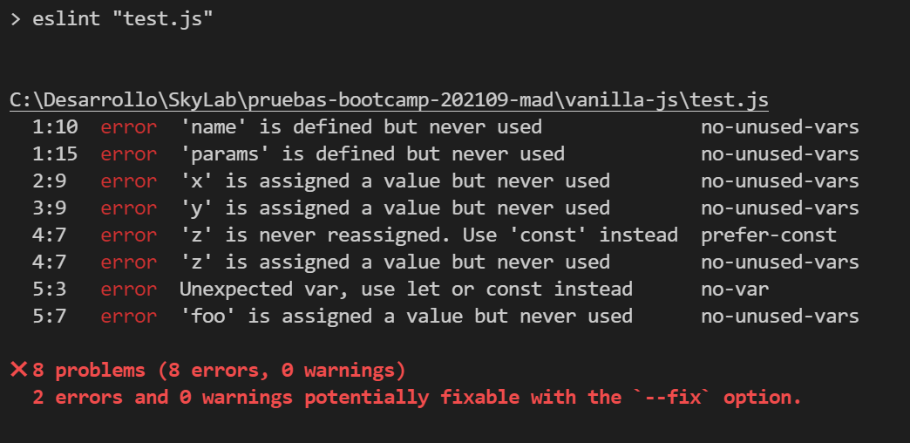
Check ESLint working
ESLin in the terminal
VSC Plugin

Slide 40
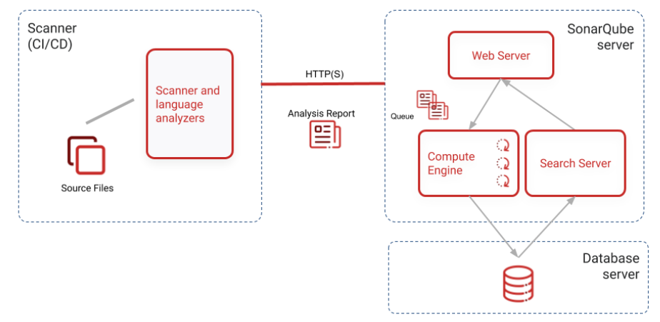
Sonarqube
A SonarQube instance comprises three components:

Slide 41
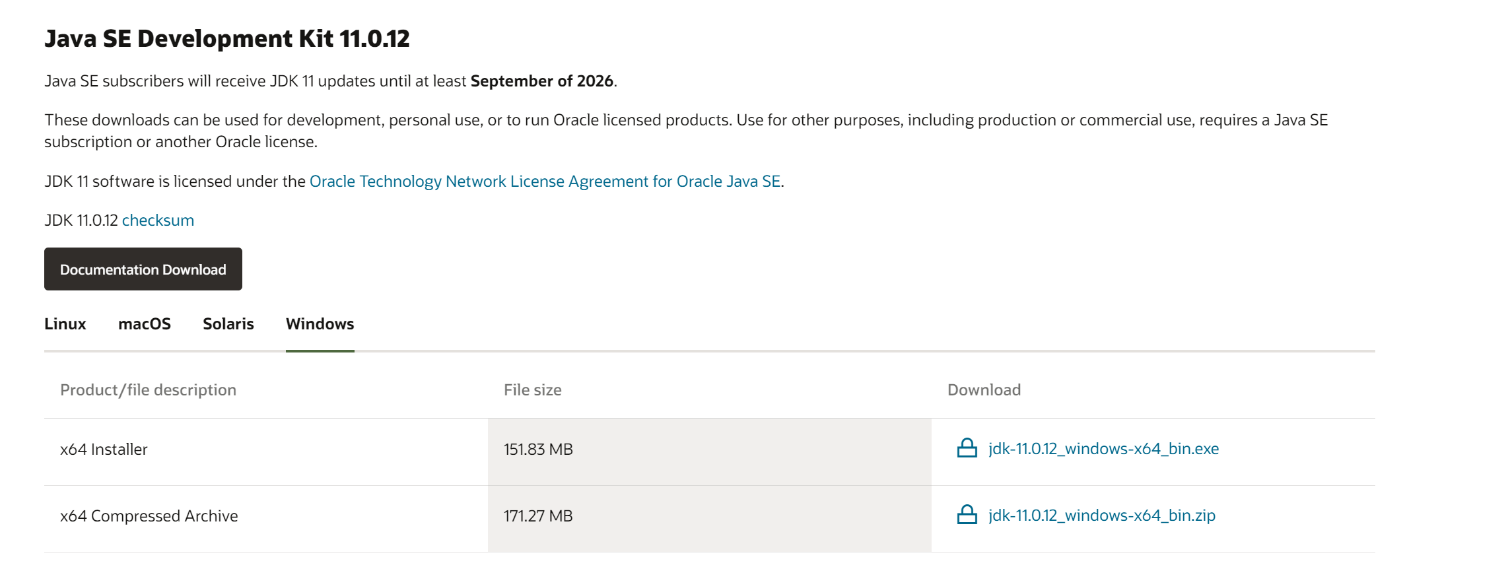
Prerequisite
SonarQube scanners and the SonarQube server require Java version 11
https://www.oracle.com/java/technologies/downloads/#java11

Slide 42
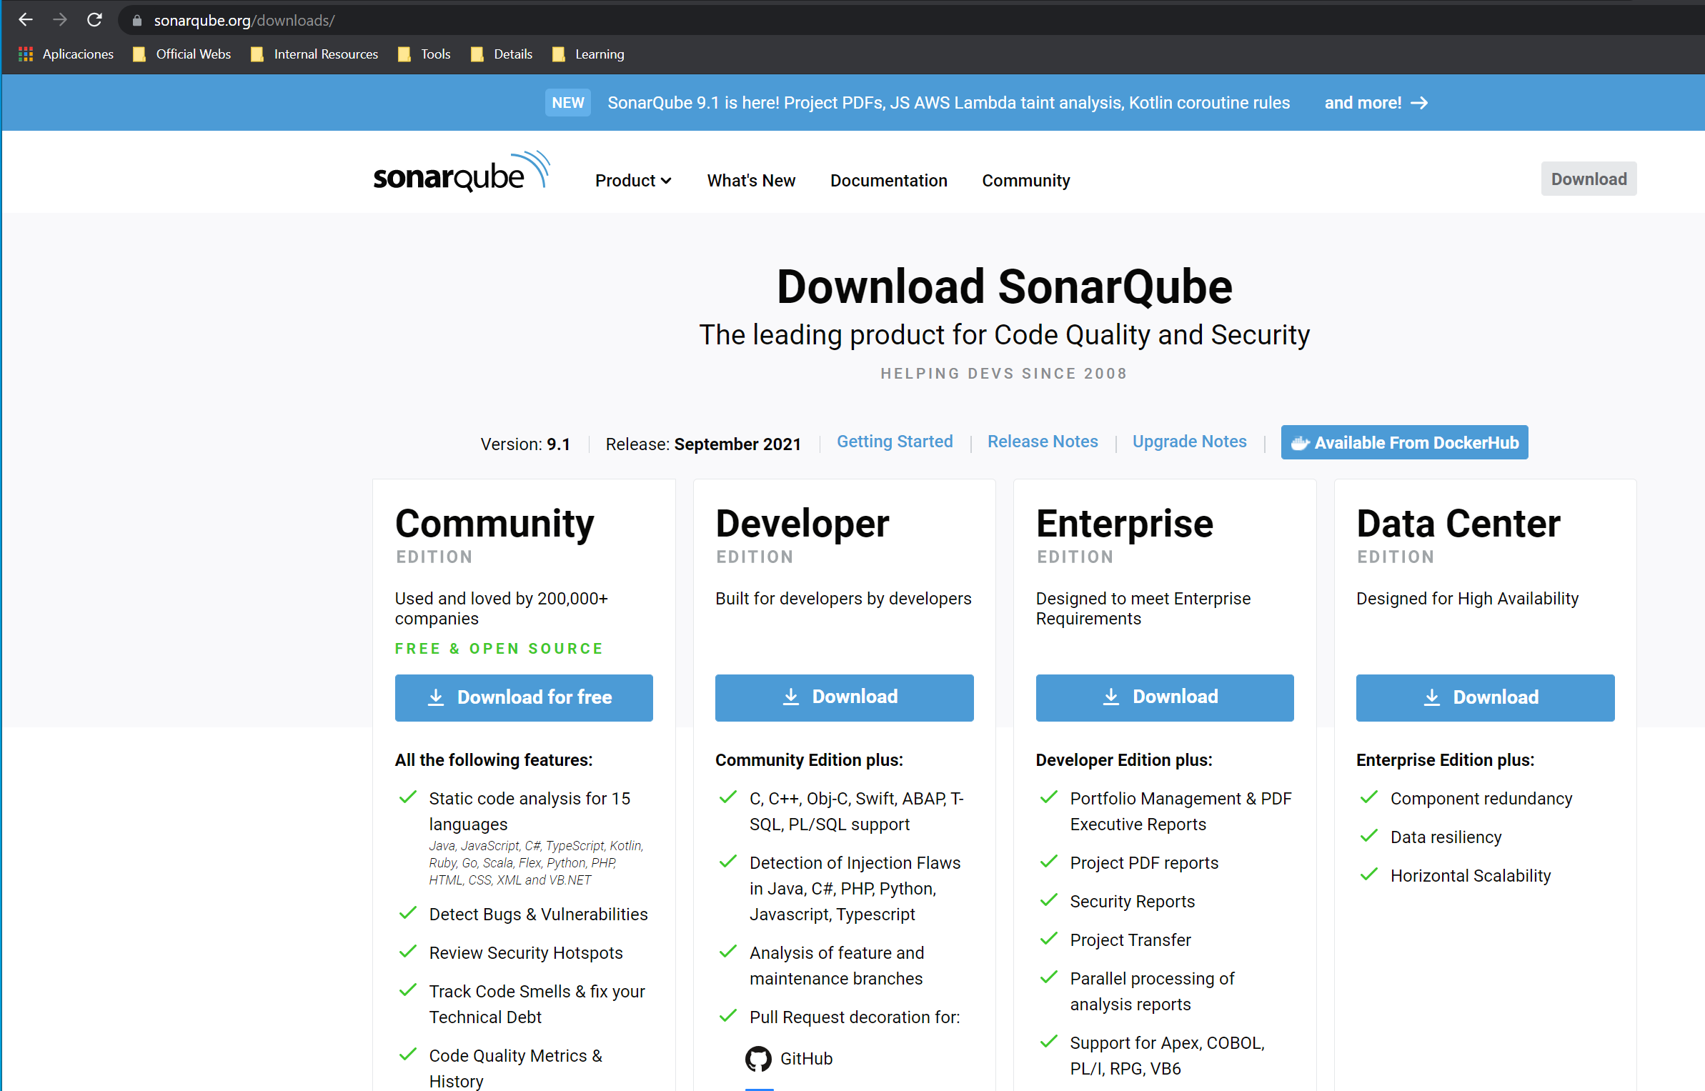
Sonarqube Server
Download de server sonarqube-9.1.0.47736
Extract folder

Slide 43
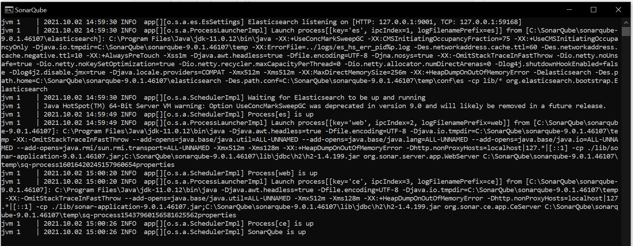
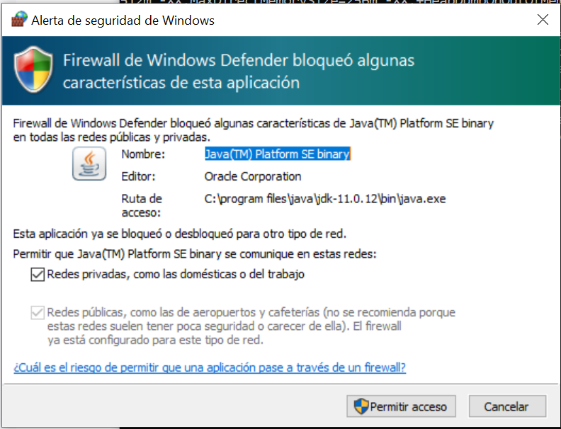
Run Server
"C:\SonarQube\sonarqube-9.0.1.46107\bin\windows-x86-64\StartSonar.bat"

Slide 44


Login
You can now browse SonarQube at http://localhost:9000 default System administrator credentials are admin/admin

Slide 45




Create project

Slide 46

Scanners
https://docs.sonarqube.org/latest/analysis/overview/

Slide 47

Install a scanner (CLI)
https://docs.sonarqube.org/latest/analysis/scan/sonarscanner/
sonar-scanner-cli-4.6.2.2472-windows.zip
sonar-scanner-cli-4.6.2.2472-macosx.zip
Extract folder

Slide 48
Configuring your project
Add the $install_directory/bin directory to your path.
Verify your installation by opening a new shell and executing the command sonar-scanner -h
Run the following command from the project base directory to launch analysis
sonar-scanner.bat -D"sonar.projectKey=Prueba" -D"sonar.sources=." -D"sonar.host.url=http://localhost:9000" -D"sonar.login=fd8c775d003505c5714901c510e31696e03982a7"
Create a configuration file in your project's root directory called sonar-project.properties

Slide 49

Google Chrome
Visual Studio Code
Git
NodeJS / npm
SonarQube

Slide 50


